Slide 1
Python programming
Project Topic: Effect of snow on soil erosion – Raster calculations
Theresa Blaich
Kilian Mouris

Slide 2
Project Idea
Overview
Extension of the RUSLE approach to estimate soil erosion by including the effects of snowfall and snowmelt → distinguish between precipitation in the form of rain (erosive) or snow (non-erosive), already done → identify snow cover from satellite images, already done → identify subsequent snowmelt to include its erosive forces, Project work
Snowfall (mm) per month
Snow at the end of each month (mm)
Project Code
Snow cover at the end of each month
Snowmelt per month (mm)

Slide 3
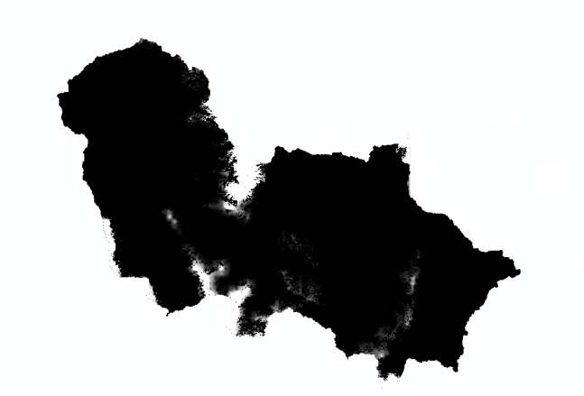
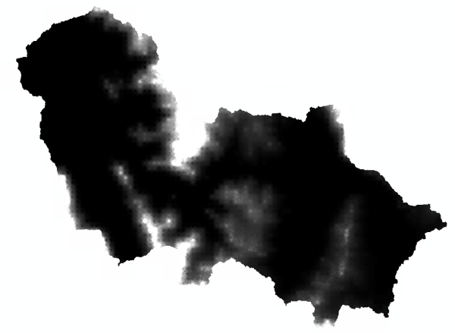
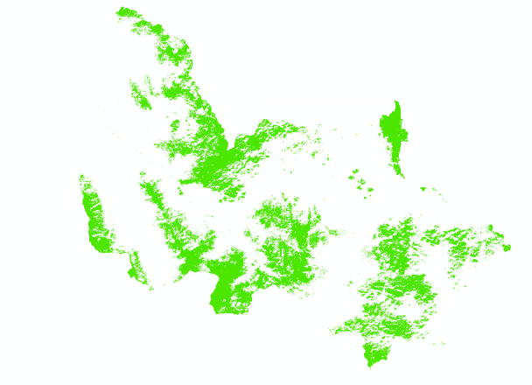
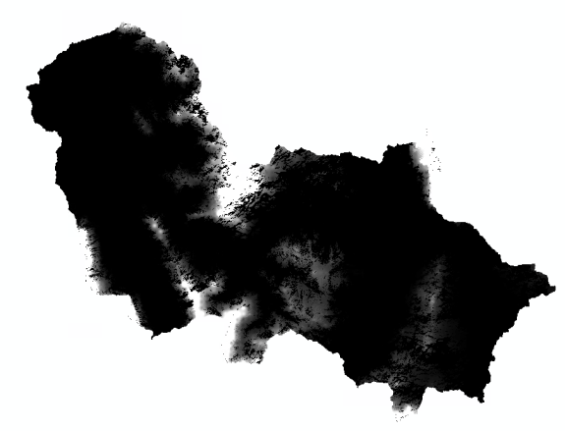
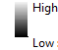
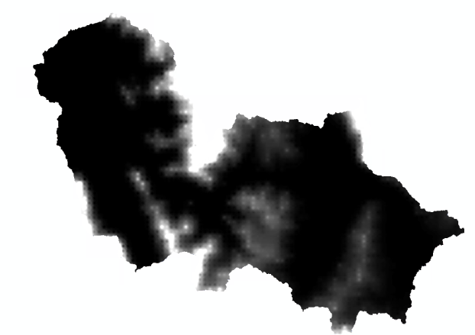
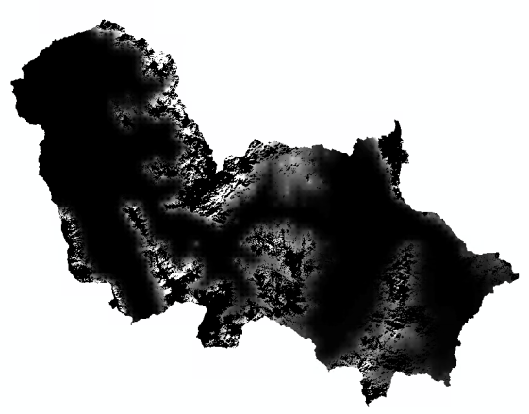
Project Idea
Calculations using December as an example
Snow end of November (mm)
Total snow December (mm)
Snow cover end of December
Snow (mm) end of December
New snow December (mm)
Transferred to January
Total snow December -Snow (mm) end of December
Snowmelt (mm) December
Erosive in December

Slide 4
Problems & Challenges
Arbitrary number of raster files as input data in a specified folder
Predefined folder where files must be stored
Get date from filenames
predefined format of filename necessary
Carry out raster calculations - considering projections, file formats, spatial resolution etc.
Extracted and checked before calculations
taking into account the temporal sequence (previous results affect the following months)
Considered in for loop
Write result files in raster format (accessible for all common GIS programs, e.g. .tiff)
Using input geotransform, projection, etc.

Slide 5
Functionality

Slide 6
Diagram code design
check_functions.py
CheckInputData
compare_shape() number_of_items() compare_geotransform()
array_one array_two raster_one_path raster_two_path
raster_calculations.py
RasterCalculations
snow_at_end() snowmelt() snow_at_start()
snow_start_of_month snow_cover snow_measured
data_management.py
DataManagement
folder_creation() get_date() get_proj_data() save_raster()
path filename
main.py
raster2nestedlist() main()

Slide 7
Constituent elements
3 classes
Raster math operation
Log file?
Magic method?

Slide 8
Timeline
28th Feb
Check/add optional components
Finish ReadMe, check & correct whole project
Last weel
Next week
This week
check functionality
Deadline

Slide 9
Resource allocation
Kilian:
Class Data Management
Theresa:
Class Raster Calculations
Class Check Functions
Together:
Readme
Check & correct

Slide 10
e-mail
phone +49 (0) 711 685-
www.
University of Stuttgart

Slide 11
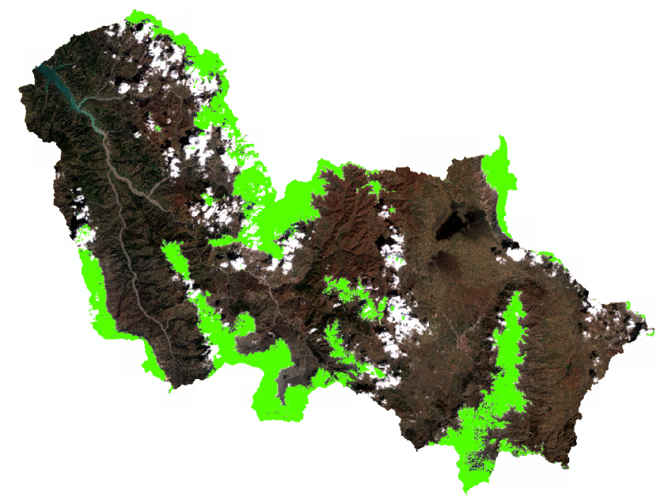
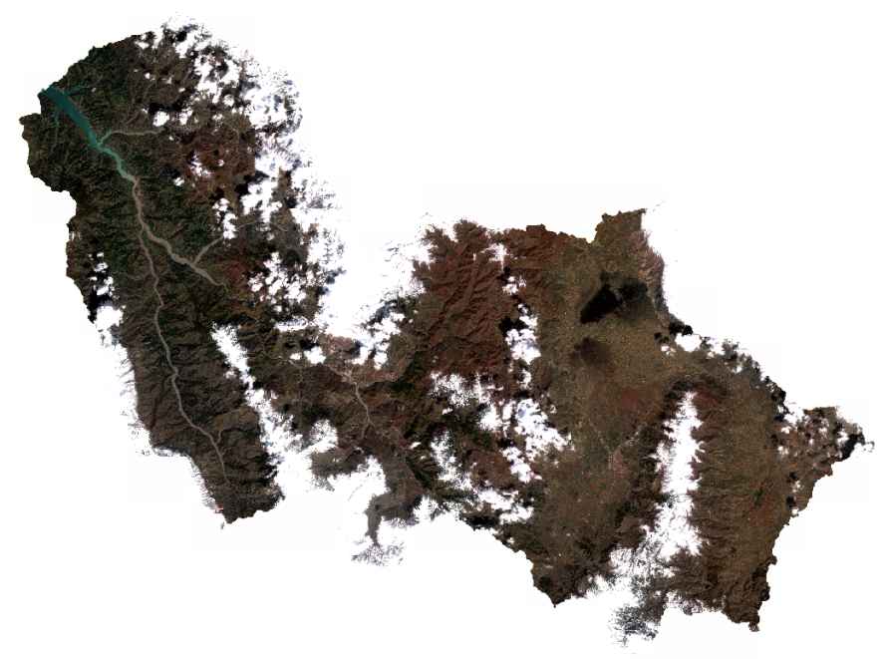
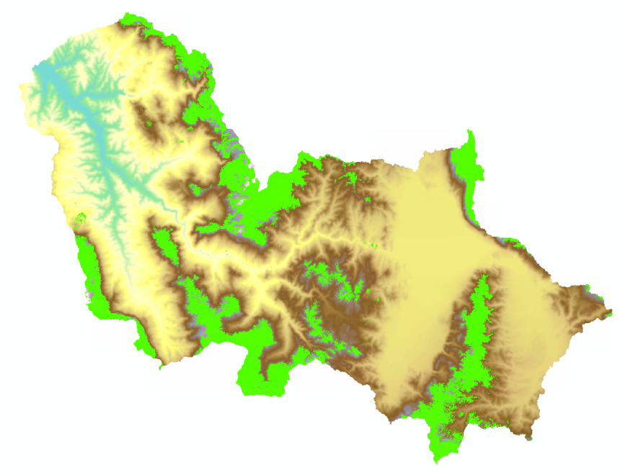
Additional

